Slide 1
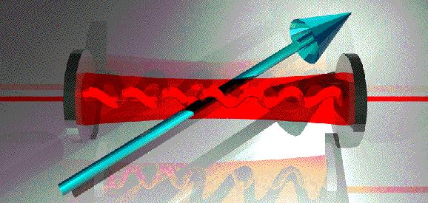
Hall A Compton electron detector status
Camsonne
Hall A collaboration meeting
December 15th 2009

Slide 2
Compton electron detector
Review of project
Issues
Status, results
Timeline

Slide 3
Electron detector
Installation August 2008
Transversity
No dedicated commissioning time
“production data”
In beam in January, detector cannot go in beam, dark current grows rapidly -> Thicker shielding
Can put detector in beam but not in Compton position
d2n
L shape shielding
Can put detector in beam, no Compton events seen

Slide 4
Electron detector
February-April : additionnal manpower Bob and Diancheng Wang
Electronic tests – New electronics seems to operate correctly
First detector tests with source – difficulties to determine efficiency
Finish software, fix standalone code
He3 running
Standard DAQ : First Compton, efficiency confirmed to be low
Analog signals available
July August
detector tests with source confirms low efficiency
Pick-up from motor
Cross-talk ( reduced to half detector)
Grounding
Happex

Slide 5
Electron detector
Happex
Low current coincidence for photon DAQ calibration
( Efficiency low and background)
Analysis
Asymmetries
PVDIS : background too high for any measurements

Slide 6
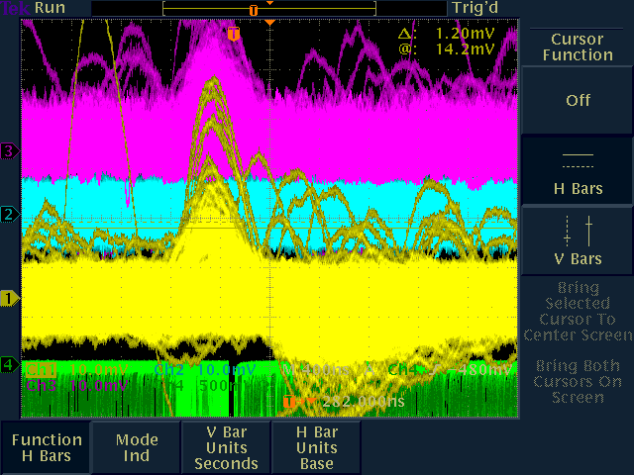
Efficiency
Signal over background ratio is poor
Noise
Signal size

Slide 7
Noise
Intrinsic noise
Capacitance larger than expected
Pickup
Improved grounding, seem to reach the intrinsic noise
Cross Talk
Half of channels used fro Happex

Slide 8
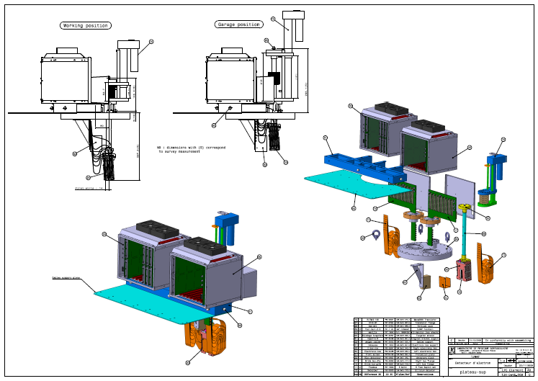
Detector design

Slide 9
Shielding
Aluminium
Previous thickness was not adequate for this detector
Sensitivity of the detector to be studied
Copper
0.5 mm of copper sufficient for 3 GeV running but not for 6 GeV ( 5 times thicker than expected )

Slide 10
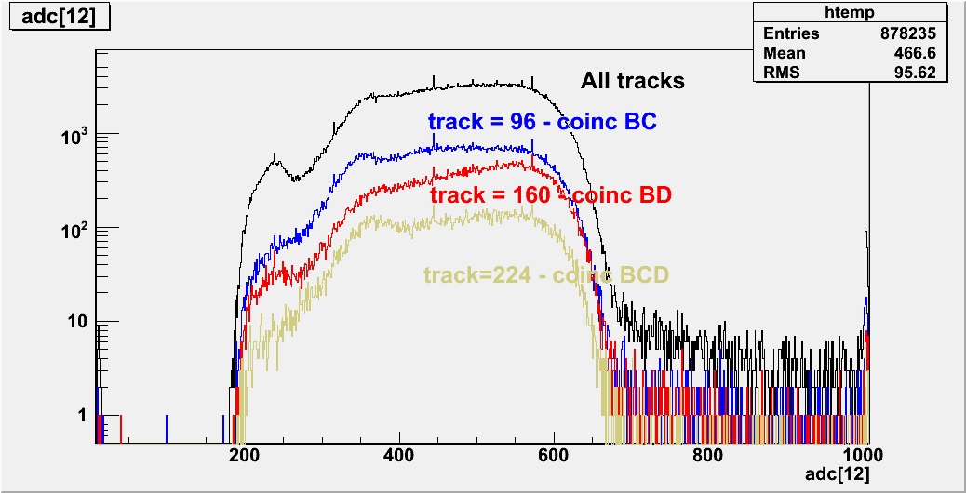
Coincidence spectrum

Slide 11
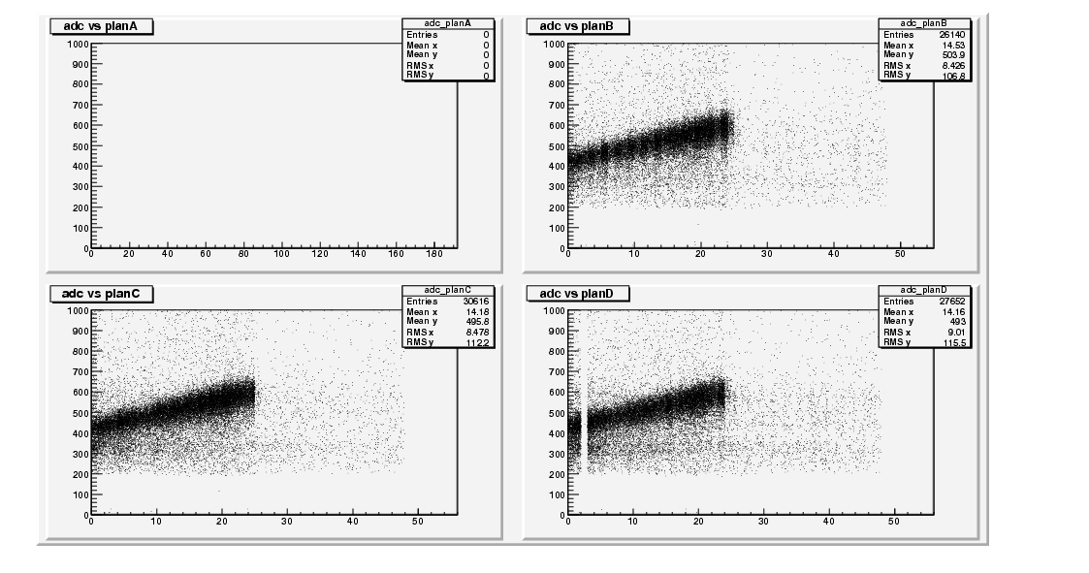
Coincidence spectrum

Slide 12
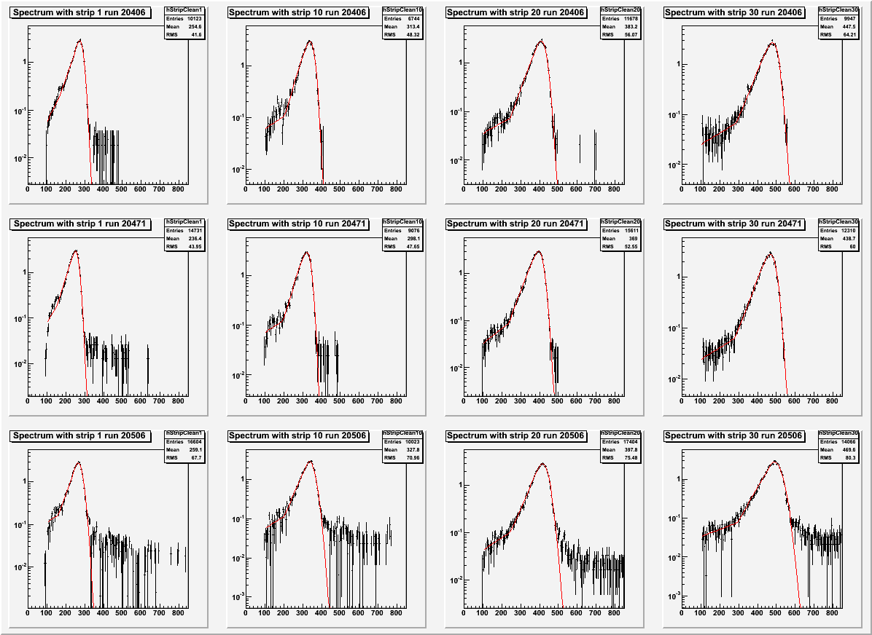
Coincidence spectrum

Slide 13
Single arm compton
Compton spectrum

Slide 14
Single arm compton
Asymmetry

Slide 15
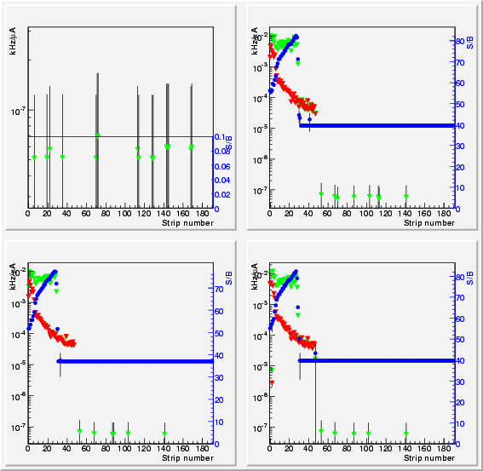
Single arm compton
Standard
analysis

Slide 16
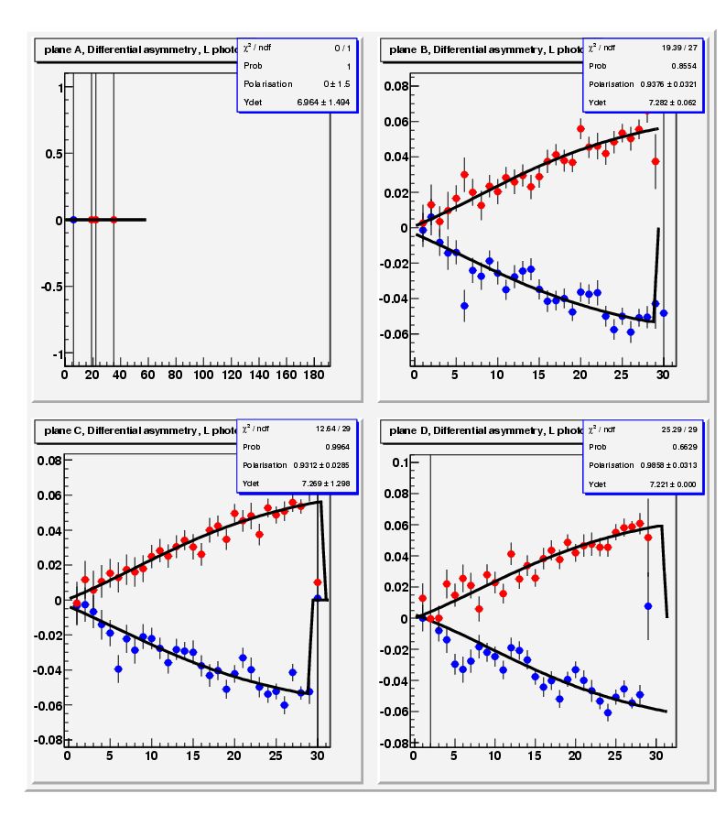
Single arm compton
Standard analysis
<PePg_R> = 0.951121 +/- (0.0292806)_{stat}
<PePg_L> = -0.885668 +/- (0.0255228)_{stat}
<PePg> = 0.913927 +/- (0.0192396)_{stat}
Roughly consistant with Moller
To be corrected for background
Contamination
Systematics to be studied

Slide 17
Status
System works imperfectly
Problem at high rate coincidence
Junk events
Low efficiency
Odd distribution changes between different modes ( dead time issues)
Background at high energy
Effect of shielding
PREX
DAQ, software work during the down ( uncertainty about the 240 Hz flip rate )
Lower energy for PREX

Slide 18
Conclusion
Detector is working sufficiently for calibration, might get a reasonable counting photon if run continuously
Single measurement accuracy not clear needs time and data to be studied
Significant amount of work needed to get a 100 % functional detector
Should work at least as well as HAPPEX III as far as detector is concerned
Question mark for standard DAQ at 240 Hz

